Slide 1
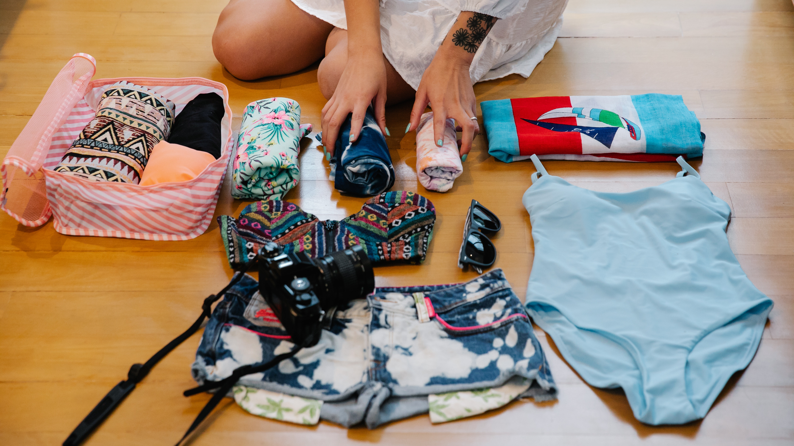
Simple Travel Packing List
Playhouse Media Group

Slide 2
PACK THESE ITEMS
Clothes
Underwear
Pants and/or shorts
Shirts (long- or short-sleeve)
Socks & T-shirts/Pajamas
1 rain jacket
One dressy outfit
Cold weather outfit
Cosmetics
Sunscreen
Mascara
Lotion
Lip Balm
Eye Liner
Eyebrow wax / pencil
Insect Repellent

Slide 3
Don’t Forget Your Medications
Tylenol
Ibuprofen
Motrin
Alka-Seltzer
Multivitamins
Eye Drops
Dramamine

